Slide 1

TECHNICAL COMMUNICATION SKILLS
GHANA COMMUNICATION TECHNOLOGY UNIVERSITY
BY
MICHAEL KWAME APPIAH
Email: mappiah@gctu.edu.gh
Telephone:+233243530809

Slide 2
OVERVIEW OF COMMUNICATION
Communication skills is a requirement for everyone. You need it in your personal life, school/college life, and professional life. No matter what profession you are in, communication skills give an extra edge. Communication skills can be improved by understanding the basic theoretical concepts, implementing them, and practicing them.
To be accepted in today’s competitive world, you need to be able to write well and speak well. You have to speak and write correct English, with clarity in expression. Unfortunately, communication is a practical subject. It is important to understand the concepts and theory. More importantly, able to practice it well.

Slide 3
What is communication?
“Communication is a process of sharing information with another person in such a way that he or she understands what you are saying.” – Dr. H. Norman Writing
Communication is a tool with which we exercise our influence on others, bring out changes in our and others’ attitudes, motivate the people around us and establish and maintain relationships with them. Communication makes a major part of our active life and is a social activity. This social activity is pursued verbally through speech, reading and writing or non-verbally through body language.

Slide 4
Why is communication important?
In the information age, we send, receive, and process huge numbers of messages every day. It could be via different medium—face-to-face, email, phone, text message, WhatsApp, Facebook, twitter, etc. Effective communication is about more than just exchanging information. It is also about understanding the emotion behind the information, the reason for transmitting the information, ensuring that the receiver will not be confused and will receive the correct information.

Slide 5
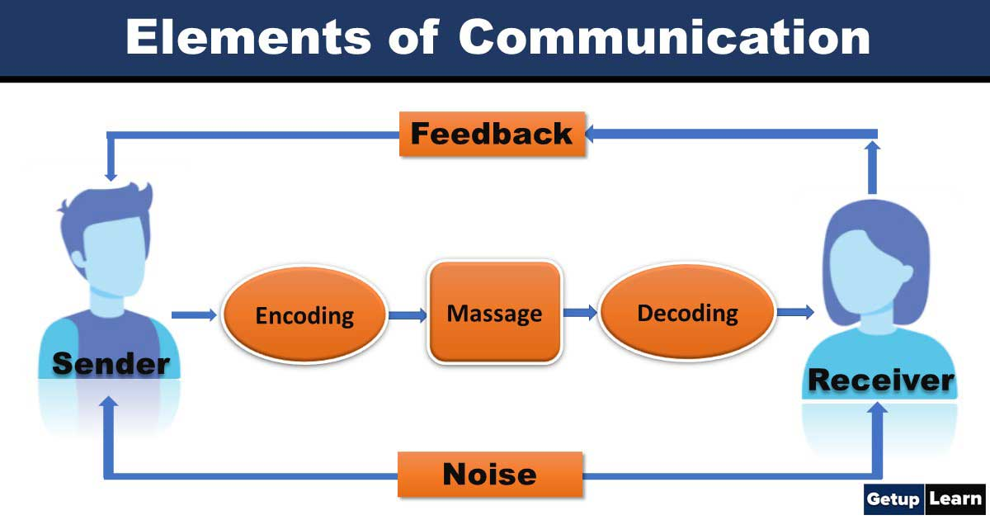

Slide 6
ELEMENTS OF COMMUNICATION
The seven major elements of communication process are:
(1) Sender:
The person who intends to convey the message with the intention of passing information and ideas to others is known as sender or communicator.
(2) Ideas:
This is the subject matter of the communication. This may be an opinion, attitude, feelings, views, orders, or suggestions.

Slide 7
(3) Encoding:
Since the subject matter of communication is theoretical and intangible, its further passing requires use of certain symbols such as words, actions or pictures etc. Conversion of subject matter into these symbols is the process of encoding.
(4) Communication Channel:
The person who is interested in communicating has to choose the channel for sending the required information, ideas etc. This information is transmitted to the receiver through certain channels which may be either formal or informal.

Slide 8
(5) Receiver:
Receiver is the person who receives the message or for whom the message is meant for. It is the receiver who tries to understand the message in the best possible manner in achieving the desired objectives.
(6) Decoding:
The person who receives the message or symbol from the communicator tries to convert the same in such a way so that he may extract its meaning to his complete understanding.
(7) Feedback:
Feedback is the process of ensuring that the receiver has received the message and understood in the same sense as sender meant it.

Slide 9
FEEDBACK IN COMMUNICATION
What is feedback in communication?
Feedback in communication is defined as the response the receiver has on the message that has been delivered to it.
Feedback is important in communication because it enables the sender to evaluate the effectiveness of its message.
Without feedback, the communication process would be incomplete.

Slide 10
Why is Feedback Important in Communication
Feedback shows if the recipient has received the message and whether the message has been understood in the same terms as intended by the sender.
Feedback signals the level of effective communication between the two parties.
Feedback is a valuable communication skill that helps improve human relationships.
Feedback is an excellent tool for continuous learning.
Constructive feedback motivates the sender.

Slide 11
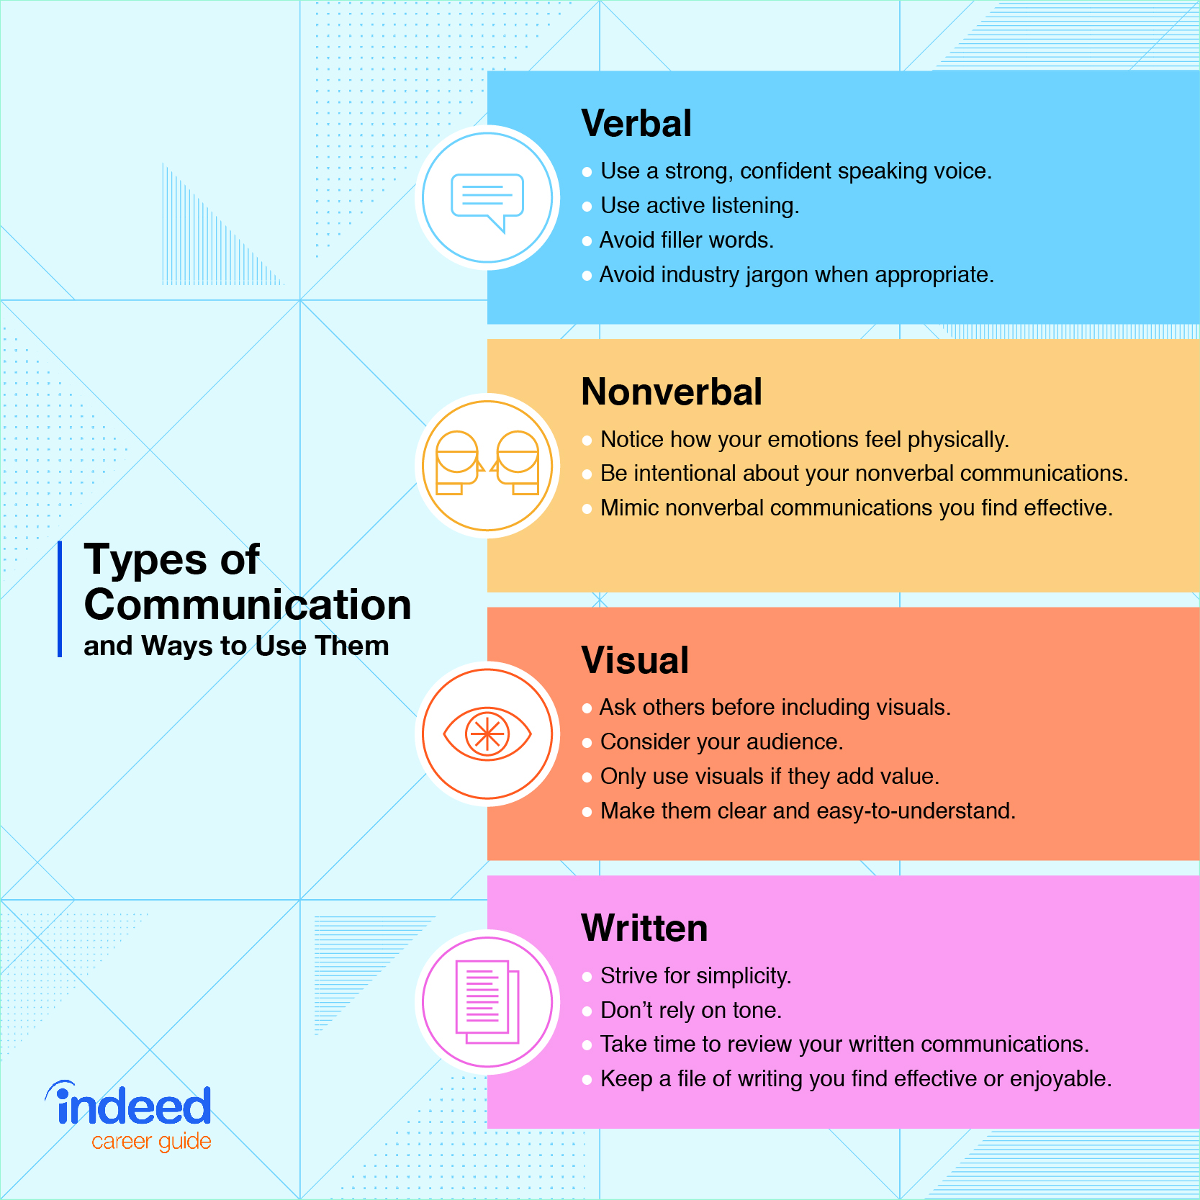
TYPES OF COMMUNICATION

Slide 12
Verbal Communication
In this type of communication, you listen to a person to understand what they are saying and comprehend the meaning. It implies communication through mouth. It includes individuals conversing with each other, be it direct conversation or telephonic conversation. Speeches, presentations, discussions are all forms of oral communication. Verbal communication takes place in real time.
Verbal/oral communication is recommended when a direct interaction is required. Face-to-face communication (meetings, lectures, conferences, interviews, etc.) is significant to build a rapport and trust

Slide 13
Advantages of verbal communication
➔ There is high level of understanding and transparency in oral communication as it is interpersonal.
➔ There is no element of rigidity in oral communication. There is flexibility for allowing changes in the decisions previously taken.
➔ The feedback is spontaneous in case of oral communication. Thus, decisions can be made quickly without any delay.
➔ It is not only time saving, but it also saves upon money and efforts.

Slide 14
Limitations of Verbal Communication
➔ Relying only on verbal communication may not be sufficient as business communication is formal and very organized.
➔ It is less authentic than written communication as they are informal and not as organized as written communication.
➔ Though it is time-saving in daily interactions, but in case of meetings, long speeches consume lot of time and are unproductive at times.

Slide 15
Written Communication
In contrast to verbal communications, written business communications are printed messages. It has great significance in today’s business world. It is an innovative activity of the mind. Written communication is the most important and the most effective of any mode of business communication.
Memos
Reports
Bulletins
Job descriptions
Employee manuals
E-mails BREAK: What are the advantages of written communication?

Slide 16
Disadvantages of Written Communication
➔ Written communication costs in terms of stationery and the manpower employed in writing/typing and delivering letters.
➔ If the receivers of the written message are separated by distance and if they need to clear their doubts, the response is not spontaneous.
Written communication is time-consuming as the feedback is not immediate. The encoding and sending of message takes time.
➔ Effective written communication requires great skills and competencies in language and vocabulary use. Poor writing skills and quality, have a negative impact on the organization’s reputation.

Slide 17
Non-verbal
Nonverbal communication as the name suggested does not have any verbal or spoken words for communication. In this type of communication, you observe a person and infer the meaning. It involves the nonverbal stimuli in a communication setting that are generated by the source (speaker). It involves sending and receiving messages through gestures, actions, facial expressions, body language, clothing, and other aspects of your physical appearance, that, when seen, communicate something.

Slide 18
Factors that help Non-verbal communication
Culture
Body Language
Facial expression
Appearance

Slide 19
Visual communication
Visual communication is a way that people communicate and share information through images and visuals.
Visual communication is the transmission of information and ideas using symbols and imagery. It is one of three main types of communication, along with verbal communication (speaking) and non-verbal communication (tone, body language, etc.). Visual communication is believed to be the type that people rely on most, and it includes signs, graphic designs, films, typography,

Slide 20
Difference between interpersonal and intrapersonal communication.
As the term, ‘intra’ means ‘within’, so the communication that takes place within a person is called intrapersonal communication. On the other hand, the term ‘inter’ means ‘between’, so when the communication occurs between two or more persons, it is said to be interpersonal communication.
Intrapersonal communication can be anything from solving a complex problem in your mind to thinking about what to wear today or what to have for breakfast.
Interpersonal communication is the exchange of information among people.

Slide 21
Public Communication
Public communication refers to the act of dispersing a message to a specific group through the use of various tools or methods. Information can come from the government, academic courses, organizations, and political parties, to mention just a few. Public communication is crucial because it helps bridge gaps between the sender and the public. For example, the government uses public communication to bridge the gap between the citizens and the government. This also provides an avenue for citizens to interact with public administrators concerning issues that matter to them. Public communication incorporates various tools such as radio, newspaper, and social media.

Slide 22
PRINCIPLES OF COMMUNICATION
(a) Clarity:
It means the communicator should use such a language which is easy to understand. The message must be understood by the receiver. The words used should be simple and unambiguous. The language should not create any confusion or misunderstanding.
(b) Adequacy and Consistency:
The communicator must carefully take into account that the information to be communicated should be complete and adequate in all respect. Inadequate and incomplete message creates confusion and delays the action to be taken.

Slide 23
Principles of communication
Economy: In a corporate set up, unnecessary use of communication system can add to the cost. You must use the system of communication efficiently, in a timely manner and when it is necessary.
Feedback: The purpose of communication will be defeated if feedback is not taken from the receiver. The confirmation of the receipt of the message in its right perspective from its receiver fulfills the object of communication. The feedback is essential only in case of written communication and messages sent through messengers. In case of oral type of communication, we receive the feedback immediately.

Slide 24
IMPORTANCE OF EFFECTIVE COMMUNICATION
Effective communication can improve personal and professional relationships by:
(a) Increasing your capacity to recognize and understand your own emotions and those of the person you are communicating with.
(b) Combining a set of skills including nonverbal communication, attentive listening, and the ability to manage stress at the moment of communication.
(c) Enabling you to communicate even negative or difficult messages without creating conflict or destroying trust.
Deepening your connections with the person or people you are communicating with.
Improving interaction, decision-making, and problem solving

Slide 25
BARRIERS TO EFFECTIVE COMMUNICATION
Language Barriers
Language and linguistic ability may act as a barrier to communication. However, even when communicating in the same language, the terminology used in a message may act as a barrier if it is not fully understood by the receiver(s).
For example, if a doctor talks to a patient using the medical jargon the patient will not be able to understand what the doctor is trying to say. It needs to be explained in a layman’s language, without use of the medical terms. The listener will not understand the language that includes a lot of jargon and abbreviations as he is not familiar with the terminology used. You must remember to use language that can be understood by the receiver

Slide 26
Psychological Barriers
The psychological state of the receiver will influence how the message is received. For example, people having personal issues, worries, and stress may be preoccupied by their concerns and not as receptive to the message as they would be if they were not stressed. A close relative to attitudinal barriers, psychological barriers involve elements like:
1. Emotional regulation ability, specifically of emotions around anger, sadness and connection
2. Dislike of a friend or a team member
3. Disrespect
4. Discriminatory beliefs
5. The intent to harm or undermine rather than encourage and help
6. Feelings of superiority towards individuals or groups
7. Personal emotional issues resulting from past experiences

Slide 27
Physical Barriers
Physical discomfort may cause communication failures. Examples of physical barrier to communication can be:
➔ The geographic distance between the speaker and receiver(s)
➔ Physical distance between the speaker and receiver(s)
➔ Noise
➔ Poor lighting
➔ Uncomfortable sitting
➔ Unhygienic room

Slide 28
Physiological Barriers
Physiological barriers may result from the receiver’s physical state. Any psychological or emotional turbulence or disturbance can prove to be a barrier to effective communication:
(a) Sadness
Fear
Anger
Anxiety
(e) Excitement

Slide 29
Other barriers;
Gender
Attitudinal
Perceptual
Cultural differences
Information overload

Slide 30
SAMPLE QUESTIONS
What is Communication?
What are various elements of a communication cycle?
What is effective communication?
What are the types of communication?
What are the advantages and disadvantages of verbal communication?
What is feed back?
What are the barriers of communication?

